Slide 1
My Audio Visualisation
By Thomas Kerslake

Slide 2
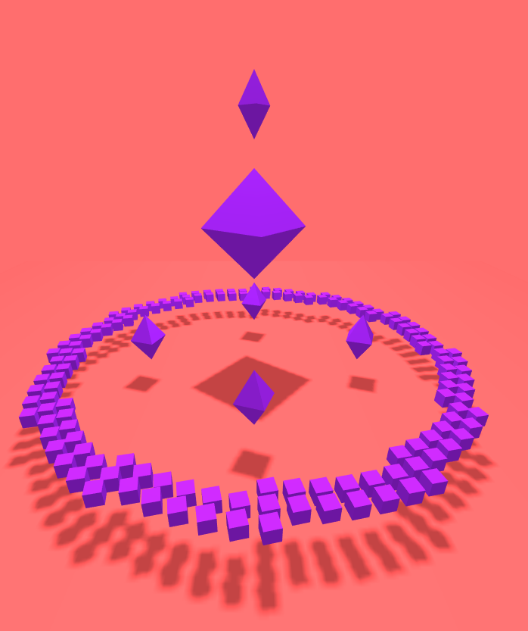
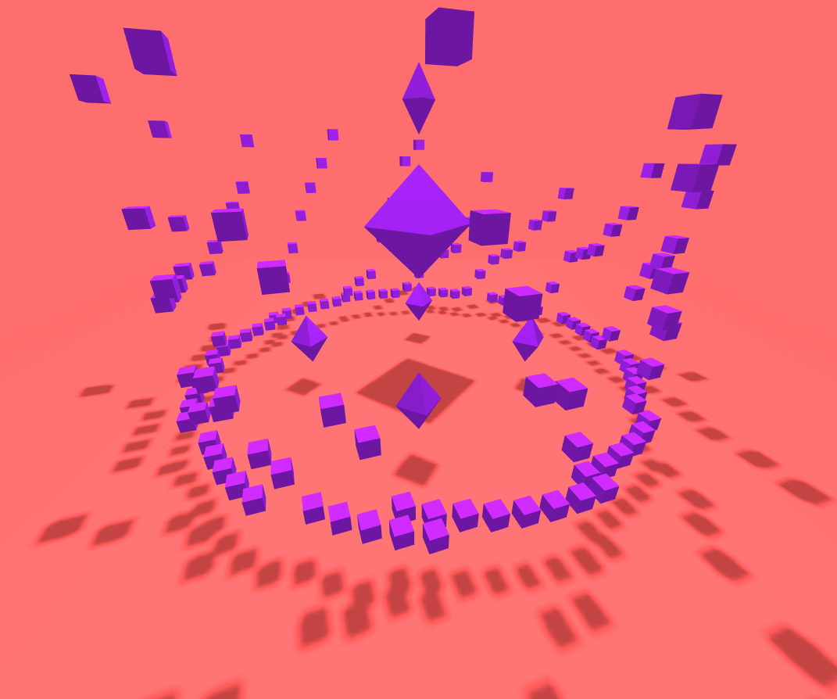
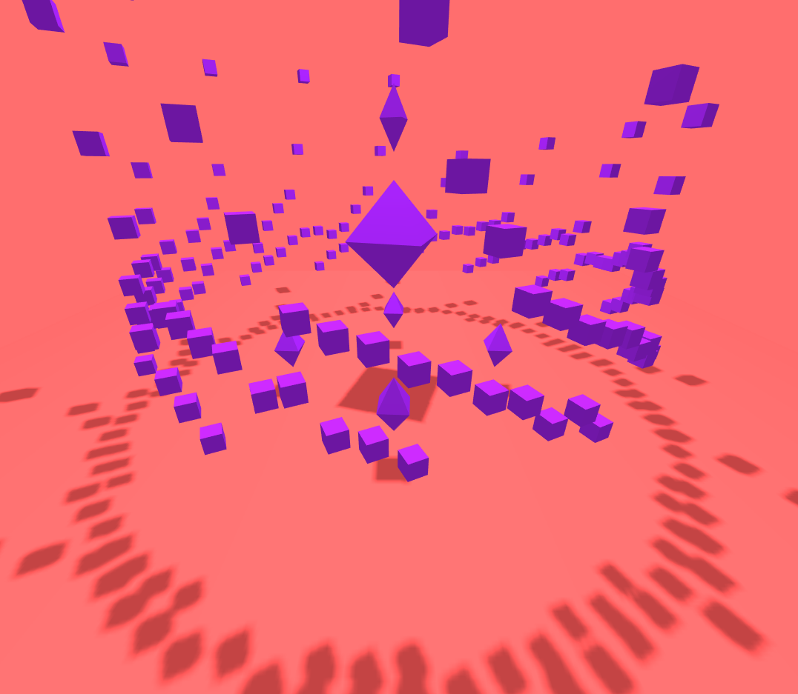
Current design /
Progress

Slide 3
Direction?
Open to any direction as I have chosen not to restrict myself to an aesthetic for the design just yet - still exploring.
Functionality wise I’m contemplating implementing VR to make a VR audio visualisation - design choices my impact this or be a product of.

Slide 4
Purpose?
Possibly to create something that would be somewhat of an online radio station that would have multiple styles / options for visualization that a user could select for music being played.
Maybe a visualization that would aim to be an audio visualization for a specific club / festival / event.

Slide 5
Music preferences?
I have not yet decided on what music I'm going to use - Obviously the choice could heavily impact the design / aesthetic I intend to create.
I have considered songs such as Born Slippy by Underworld and 9 PM (Till I Come) by ATB. 90s Electronic music is a possible design I may work with.

Slide 6
End.

